Slide 1
Introduction to Sockets Programming in C
using TCP/IP

Slide 2


Introduction
Computer Network
hosts, routers,
Host
communication channels
Hosts run applications
Routers forward information
Packets: sequence of bytes
contain control information
e.g. destination host
Protocol is an agreement
meaning of packets
structure and size of packets
e.g. Hypertext Transfer Protocol (HTTP)
Router
Communication
channel

Slide 3
Protocol Families - TCP/IP
Several protocols for different problems
Protocol Suites or Protocol Families: TCP/IP
TCP/IP provides end-to-end connectivity specifying how data should be
formatted,
addressed,
transmitted,
routed, and
received at the destination
can be used in the internet and in stand-alone private networks
it is organized into layers

Slide 4
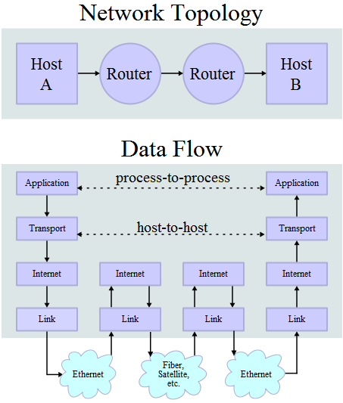
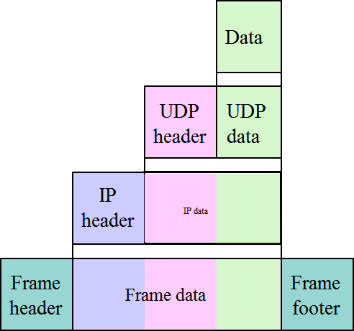
TCP/IP
*
FTP, SMTP, …
Transport Layer TCP or UDP
Network Layer IP
Communication Channels
* image is taken from “http://en.wikipedia.org/wiki/TCP/IP_model”

Slide 5

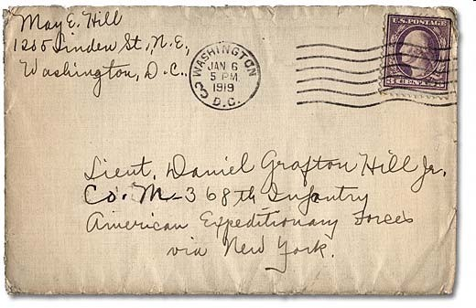
Internet Protocol (IP)
provides a datagram service
packets are handled and delivered independently
best-effort protocol
may loose, reorder or duplicate packets
each packet must contain an IP address of its destination

Slide 6
Addresses - IPv4
The 32 bits of an IPv4 address are broken into 4 octets, or 8 bit fields (0-255 value in decimal notation).
For networks of different size,
the first one (for large networks) to three (for small networks) octets can be used to identify the network, while
the rest of the octets can be used to identify the node on the network.
7
0 Network ID
24
Host ID
Range of addresses
1.0.0.0 to 127.255.255.255
Class A:
14
16
Host ID
128.0.0.0 to 191.255.255.255
Class B:
1 0
Network ID
Class C: | 1 | 1 | 0 |  | 21 Network ID |  | 8 Host ID
 |  |  |  |  |  | 28
Class D (multicast): | 1 | 1 | 1 | 0 | Multicast | address
192.0.0.0 to 223.255.255.255
224.0.0.0 to 239.255.255.255
27
240.0.0.0 to 255.255.255.255
Class E (reserved):
1 1 1 1 0
unused

Slide 7
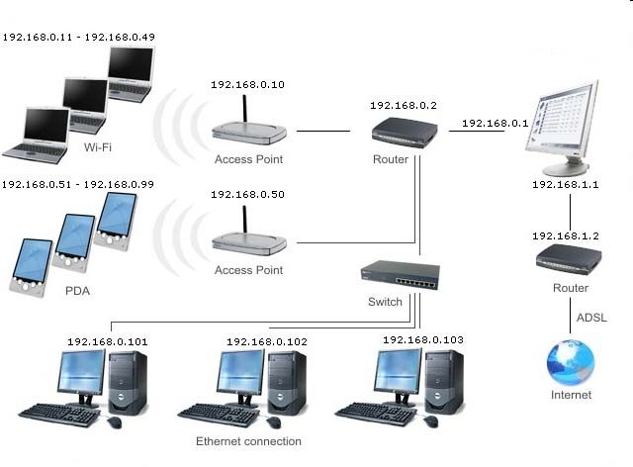
Local Area Network Addresses - IPv4

Slide 8
TCP vs UDP
Both use port numbers
application-specific construct serving as a communication endpoint
16-bit unsigned integer, thus ranging from 0 to 65535
 to provide end-to-end transport
UDP: User Datagram Protocol
no acknowledgements
no retransmissions
out of order, duplicates possible
connectionless, i.e., app indicates destination for each packet
TCP: Transmission Control Protocol
reliable byte-stream channel (in order, all arrive, no duplicates)
similar to file I/O
flow control
connection-oriented
bidirectional

Slide 9
TCP vs UDP
TCP is used for services with a large data capacity, and a persistent connection
UDP is more commonly used for quick lookups, and single use query-reply actions.
Some common examples of TCP and UDP with their default ports:
DNS lookup | UDP | 53
FTP | TCP | 21
HTTP | TCP | 80
POP3 | TCP | 110
Telnet | TCP | 23

Slide 10


Berkley Sockets
Universally known as Sockets
It is an abstraction through which an application may send and receive data
Provide generic access to interprocess communication services
e.g. IPX/SPX, Appletalk, TCP/IP
Standard API for networking
Application
Application
Socket
Socket
TCP
TCP
IP
Channel
IP
Channel
IP
Host
Router
Host

Slide 11
Sockets
Uniquely identified by
an internet address
an end-to-end protocol (e.g. TCP or UDP)
a port number
Two types of (TCP/IP) sockets
Stream sockets (e.g. uses TCP)
provide reliable byte-stream service
Datagram sockets (e.g. uses UDP)
provide best-effort datagram service
messages up to 65.500 bytes
Descriptor Table
internal data structure for file 1
0
1
2
Family: PF_INET
Service: SOCK_STREAM
Local_IP:
Remote_IP:
Local_Port:
Remote_Port:
…
Socket extend the convectional UNIX I/O facilities
file descriptors for network communication
extended the read and write system calls

Slide 12
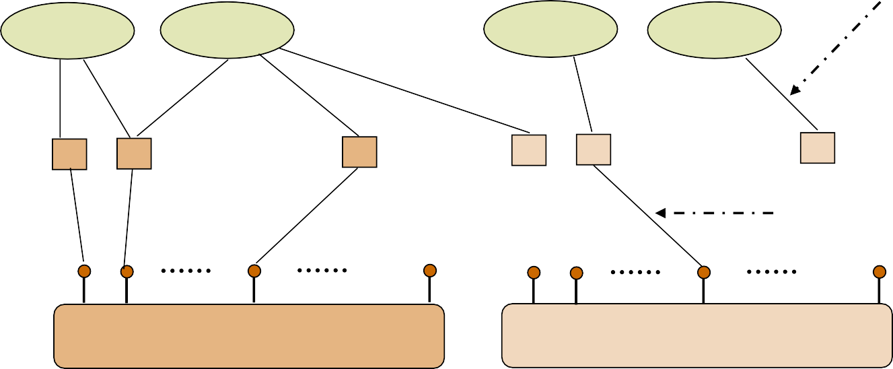
Sockets
Descriptor references
Applications
TCP sockets
UDP sockets
Sockets bound to ports
TCP ports
1 2
65535
1 2
65535 UDP ports
TCP
UDP
IP

Slide 13

Socket Programming

Slide 14
Client-Server communication
Server
passively waits for and responds to clients
passive socket
Client
initiates the communication
must know the address and the port of the server
active socket

Slide 15
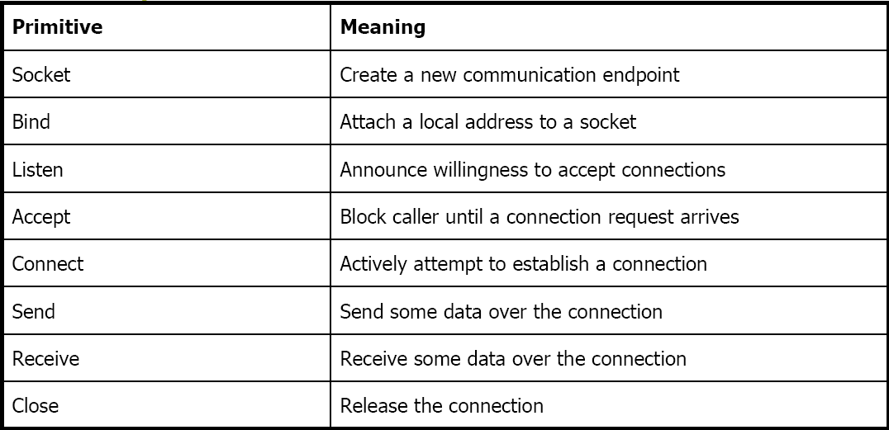
Sockets - Procedures

Slide 16
Client - Server Communication - Unix
Stream (e.g. TCP)
Datagram (e.g. UDP)
Server
Client
Server
Client
socket()
socket()
socket()
socket()
bind()
bind()
bind()
listen()
synchronization point
accept()
connect()
recv()
send()
recvfrom()
sendto()
send()
recv()
sendto()
recvfrom()
close()
close()
close()
close()

Slide 17
Socket creation in C: socket()
int sockid = socket(family, type, protocol);
sockid: socket descriptor, an integer (like a file-handle)
family: integer, communication domain, e.g.,
PF_INET, IPv4 protocols, Internet addresses (typically used)
PF_UNIX, Local communication, File addresses
type: communication type
SOCK_STREAM - reliable, 2-way, connection-based service
SOCK_DGRAM - unreliable, connectionless, messages of maximum length
protocol: specifies protocol
IPPROTO_TCP IPPROTO_UDP
usually set to 0 (i.e., use default protocol)
upon failure returns -1
NOTE: socket call does not specify where data will be coming fr rom, nor where it will be going to – it just creates the interface!

Slide 18
Client - Server Communication - Unix
Stream (e.g. TCP)
Datagram (e.g. UDP)
Server
Client
Server
Client
socket()
socket()
socket()
socket()
bind()
bind()
bind()
listen()
synchronization point
accept()
connect()
recv()
send()
recvfrom()
sendto()
send()
recv()
sendto()
recvfrom()
close()
close()
close()
close()

Slide 19
Socket close in C: close()
When finished using a socket, the socket should be closed
status = close(sockid);
sockid: the file descriptor (socket being closed)
status: 0 if successful, -1 if error
Closing a socket
closes a connection (for stream socket)
frees up the port used by the socket

Slide 20
Specifying Addresses
Socket API defines a generic data type for addresses:
struct sockaddr {
unsigned short sa_family; /* Address family (e.g. AF_INET) */
char sa_data[14]; /* Family-specific address information */
}
Particular form of the sockaddr used for TCP/IP addresses:
struct in_addr {
unsigned long s_addr; /* Internet address (32 bits) */
}
struct sockaddr_in {
unsigned short sin_family; unsigned short sin_port; struct in_addr sin_addr; char sin_zero[8];
/* Internet protocol (AF_INET) */
/* Address port (16 bits) */
/* Internet address (32 bits) */
/* Not used */
}
Important: sockaddr_in can be casted to a sockaddr

Slide 21
Client - Server Communication - Unix
Stream (e.g. TCP)
Datagram (e.g. UDP)
Server
Client
Server
Client
socket()
socket()
socket()
socket()
bind()
bind()
bind()
listen()
synchronization point
accept()
connect()
recv()
send()
recvfrom()
sendto()
send()
recv()
sendto()
recvfrom()
close()
close()
close()
close()

Slide 22
Assign address to socket: bind()
associates and reserves a port for use by the socket
int status = bind(sockid, &addrport, size);
sockid: integer, socket descriptor
addrport: struct sockaddr, the (IP) address and port of the machine
for TCP/IP server, internet address is usually set to INADDR_ANY, i.e., chooses any incoming interface
size: the size (in bytes) of the addrport structure
status: upon failure -1 is returned

Slide 23
bind()- Example with TCP
int sockid;
struct sockaddr_in addrport;
sockid = socket(PF_INET, SOCK_STREAM, 0);
addrport.sin_family = AF_INET; addrport.sin_port = htons(5100); addrport.sin_addr.s_addr = htonl(INADDR_ANY);
if(bind(sockid, (struct sockaddr *) &addrport, sizeof(addrport))!= -1) {
…}

Slide 24
Skipping the bind()
bind can be skipped for both types of sockets
Datagram socket:
if only sending, no need to bind. The OS finds a port each time the socket sends a packet
if receiving, need to bind
Stream socket:
destination determined during connection setup
don’t need to know port sending from (during connection setup, receiving end is informed of port)

Slide 25
Client - Server Communication - Unix
Stream (e.g. TCP)
Datagram (e.g. UDP)
Server
Client
Server
Client
socket()
socket()
socket()
socket()
bind()
bind()
bind()
listen()
synchronization point
accept()
connect()
recv()
send()
recvfrom()
sendto()
send()
recv()
sendto()
recvfrom()
close()
close()
close()
close()

Slide 26
Assign address to socket: bind()
Instructs TCP protocol implementation to listen for connections
int status = listen(sockid, queueLimit);
sockid: integer, socket descriptor
queuelen: integer, # of active participants that can “wait” for a connection
status: 0 if listening, -1 if error
listen() is non-blocking: returns immediately
The listening socket (sockid)
is never used for sending and receiving
is used by the server only as a way to get new sockets

Slide 27
Client - Server Communication - Unix
Stream (e.g. TCP)
Datagram (e.g. UDP)
Server
Client
Server
Client
socket()
socket()
socket()
socket()
bind()
bind()
bind()
listen()
synchronization
accept()
point
connect()
recv()
send()
recvfrom()
sendto()
send()
recv()
sendto()
recvfrom()
close()
close()
close()
close()

Slide 28
Establish Connection: connect()
The client establishes a connection with the server by calling
connect()
int status = connect(sockid, &foreignAddr, addrlen);
sockid: integer, socket to be used in connection
foreignAddr: struct sockaddr: address of the passive participant
addrlen: integer, sizeof(name)
status: 0 if successful connect, -1 otherwise
connect() is blocking

Slide 29
Incoming Connection: accept()
The server gets a socket for an incoming client connection by calling
accept()
int s = accept(sockid, &clientAddr, &addrLen);
s: integer, the new socket (used for data-transfer)
sockid: integer, the orig. socket (being listened on)
clientAddr: struct sockaddr, address of the active participant
filled in upon return
addrLen: sizeof(clientAddr): value/result parameter
must be set appropriately before call
adjusted upon return
accept()
is blocking: waits for connection before returning
dequeues the next connection on the queue for socket (sockid)

Slide 30
Client - Server Communication - Unix
Stream (e.g. TCP)
Datagram (e.g. UDP)
Server
Client
Server
Client
socket()
socket()
socket()
socket()
bind()
bind()
bind()
listen()
synchronization point
accept()
connect()
recv()
send()
recvfrom()
sendto()
send()
recv()
sendto()
recvfrom()
close()
close()
close()
close()

Slide 31
Exchanging data with stream socket
int count = send(sockid, msg, msgLen, flags);
msg: const void[], message to be transmitted
msgLen: integer, length of message (in bytes) to transmit
flags: integer, special options, usually just 0
count: # bytes transmitted (-1 if error)
int count = recv(sockid, recvBuf, bufLen, flags);
recvBuf: void[], stores received bytes
bufLen: # bytes received
flags: integer, special options, usually just 0
count: # bytes received (-1 if error)
Calls are blocking
❑ returns only after data is sent / received

Slide 32
Exchanging data with datagram socket
int count = sendto(sockid, msg, msgLen, flags, &foreignAddr, addrlen);
msg, msgLen, flags, count: same with send()
foreignAddr: struct sockaddr, address of the destination
addrLen: sizeof(foreignAddr)
int count = recvfrom(sockid, recvBuf, bufLen, flags, &clientAddr, addrlen);
recvBuf, bufLen, flags, count: same with recv()
clientAddr: struct sockaddr, address of the client
addrLen: sizeof(clientAddr)
Calls are blocking
returns only after data is sent / received

Slide 33
Example - Echo
A client communicates with an “echo” server
The server simply echoes whatever it receives back to the client

Slide 34
Example - Echo using stream socket
The server starts by getting ready to receive client connections…
Client
Create a TCP socket
Establish connection
Communicate
Close the connection
Server
Create a TCP socket
Assign a port to socket
Set socket to listen
Repeatedly:
Accept new connection
Communicate
Close the connection

Slide 35
Example - Echo using stream socket
/* Create socket for incoming connections */
if ((servSock = socket(PF_INET, SOCK_STREAM, IPPROTO_TCP)) < 0) DieWithError("socket() failed");
Client
Create a TCP socket
Establish connection
Communicate
Close the connection
Server
Create a TCP socket
Assign a port to socket
Set socket to listen
Repeatedly:
Accept new connection
Communicate
Close the connection

Slide 36
Example - Echo using stream socket
echoServAddr.sin_family = AF_INET; /* Internet address family */ echoServAddr.sin_addr.s_addr = htonl(INADDR_ANY); /* Any incoming interface */ echoServAddr.sin_port = htons(echoServPort); /* Local port */
if (bind(servSock, (struct sockaddr *) &echoServAddr, sizeof(echoServAddr)) < 0) DieWithError("bind() failed");
Client
Create a TCP socket
Establish connection
Communicate
Close the connection
Server
Create a TCP socket
Assign a port to socket
Set socket to listen
Repeatedly:
Accept new connection
Communicate
Close the connection

Slide 37
Example - Echo using stream socket
/* Mark the socket so it will listen for incoming connections */
if (listen(servSock, MAXPENDING) < 0) DieWithError("listen() failed");
Client
Create a TCP socket
Establish connection
Communicate
Close the connection
Server
Create a TCP socket
Assign a port to socket
Set socket to listen
Repeatedly:
Accept new connection
Communicate
Close the connection

Slide 38
Example - Echo using stream socket
for (;;) /* Run forever */
{
clntLen = sizeof(echoClntAddr);
if ((clientSock=accept(servSock,(struct sockaddr *)&echoClntAddr,&clntLen))<0) DieWithError("accept() failed");
...
Client
Create a TCP socket
Establish connection
Communicate
Close the connection
Server
Create a TCP socket
Assign a port to socket
Set socket to listen
Repeatedly:
Accept new connection
Communicate
Close the connection

Slide 39
Example - Echo using stream socket
Server is now blocked waiting for connection from a client
…
A client decides to talk to the server
Client
Create a TCP socket
Establish connection
Communicate
Close the connection
Server
Create a TCP socket
Assign a port to socket
Set socket to listen
Repeatedly:
Accept new connection
Communicate
Close the connection

Slide 40
Example - Echo using stream socket
/* Create a reliable, stream socket using TCP */
if ((clientSock = socket(PF_INET, SOCK_STREAM, IPPROTO_TCP)) < 0) DieWithError("socket() failed");
Client
Create a TCP socket
Establish connection
Communicate
Close the connection
Server
Create a TCP socket
Assign a port to socket
Set socket to listen
Repeatedly:
Accept new connection
Communicate
Close the connection

Slide 41
Example - Echo using stream socket
echoServAddr.sin_family = AF_INET; /* Internet address family */ echoServAddr.sin_addr.s_addr = inet_addr(echoservIP); /* Server IP address*/ echoServAddr.sin_port = htons(echoServPort); /* Server port */
if (connect(clientSock, (struct sockaddr *) &echoServAddr,
sizeof(echoServAddr)) < 0) DieWithError("connect() failed");
Client
Create a TCP socket
Establish connection
Communicate
Close the connection
Server
Create a TCP socket
Assign a port to socket
Set socket to listen
Repeatedly:
Accept new connection
Communicate
Close the connection

Slide 42
Example - Echo using stream socket
Server’s accept procedure in now unblocked and returns client’s socket
for (;;) /* Run forever */
{
clntLen = sizeof(echoClntAddr);
if ((clientSock=accept(servSock,(struct sockaddr *)&echoClntAddr,&clntLen))<0) DieWithError("accept() failed");
...
Client
Create a TCP socket
Establish connection
Communicate
Close the connection
Server
Create a TCP socket
Assign a port to socket
Set socket to listen
Repeatedly:
Accept new connection
Communicate
Close the connection

Slide 43
Example - Echo using stream socket
echoStringLen = strlen(echoString); /* Determine input length */
/* Send the string to the server */
if (send(clientSock, echoString, echoStringLen, 0) != echoStringLen) DieWithError("send() sent a different number of bytes than expected");
Client
Create a TCP socket
Establish connection
Communicate
Close the connection
Server
Create a TCP socket
Assign a port to socket
Set socket to listen
Repeatedly:
Accept new connection
Communicate
Close the connection

Slide 44
Example - Echo using stream socket
/* Receive message from client */
if ((recvMsgSize = recv(clntSocket, echoBuffer, RCVBUFSIZE, 0)) < 0) DieWithError("recv() failed");
/* Send received string and receive again until end of transmission */
while (recvMsgSize > 0) { /* zero indicates end of transmission */
if (send(clientSocket, echobuffer, recvMsgSize, 0) != recvMsgSize) DieWithError(“send() failed”);
if ((recvMsgSize = recv(clientSocket, echoBuffer, RECVBUFSIZE, 0)) < 0) DieWithError(“recv() failed”);
}
Client
Create a TCP socket
Establish connection
Communicate
Close the connection
Server
Create a TCP socket
Assign a port to socket
Set socket to listen
Repeatedly:
Accept new connection
Communicate
Close the connection

Slide 45
Example - Echo using stream socket
Similarly, the client receives the data from the server
Client
Create a TCP socket
Establish connection
Communicate
Close the connection
Server
Create a TCP socket
Assign a port to socket
Set socket to listen
Repeatedly:
Accept new connection
Communicate
Close the connection

Slide 46
Example - Echo using stream socket
close(clientSock);
close(clientSock);
Client
Create a TCP socket
Establish connection
Communicate
Close the connection
Server
Create a TCP socket
Assign a port to socket
Set socket to listen
Repeatedly:
Accept new connection
Communicate
Close the connection

Slide 47
Example - Echo using stream socket
Server is now blocked waiting for connection from a client
…
Client
Create a TCP socket
Establish connection
Communicate
Close the connection
Server
Create a TCP socket
Assign a port to socket
Set socket to listen
Repeatedly:
Accept new connection
Communicate
Close the connection

Slide 48
Example - Echo using datagram socket
/* Create socket for sending/receiving datagrams */
if ((servSock = socket(PF_INET, SOCK_DGRAM, IPPROTO_UDP)) < 0) DieWithError("socket() failed");
/* Create a datagram/UDP socket */
if ((clientSock = socket(PF_INET, SOCK_DGRAM, IPPROTO_UDP)) < 0) DieWithError("socket() failed");
Client
Create a UDP socket
Assign a port to socket
Communicate
Close the socket
Server
Create a UDP socket
Assign a port to socket
Repeatedly
Communicate
▪

Slide 49
Example - Echo using datagram socket
echoServAddr.sin_family = AF_INET; /* Internet address family */ echoServAddr.sin_addr.s_addr = htonl(INADDR_ANY); /* Any incoming interface */ echoServAddr.sin_port = htons(echoServPort); /* Local port */
if (bind(servSock, (struct sockaddr *) &echoServAddr, sizeof(echoServAddr)) < 0) DieWithError("bind() failed");
echoClientAddr.sin_family = AF_INET; /* Internet address family */ echoClientAddr.sin_addr.s_addr = htonl(INADDR_ANY); /* Any incoming interface */ echoClientAddr.sin_port = htons(echoClientPort); /* Local port */
if(bind(clientSock,(struct sockaddr *)&echoClientAddr,sizeof(echoClientAddr))<0) DieWithError("connect() failed");
Client
Create a UDP socket
Assign a port to socket
Communicate
Close the socket
Server
Create a UDP socket
Assign a port to socket
Repeatedly
Communicate
▪

Slide 50
Example - Echo using datagram socket
echoServAddr.sin_family = AF_INET; echoServAddr.sin_addr.s_addr = inet_addr(echoservIP); echoServAddr.sin_port = htons(echoServPort);
/* Internet address family */
/* Server IP address*/
/* Server port */
echoStringLen = strlen(echoString); /* Determine input length */
/* Send the string to the server */
if (sendto( clientSock, echoString, echoStringLen, 0,
(struct sockaddr *) &echoServAddr, sizeof(echoServAddr))
!= echoStringLen)
DieWithError("send() sent a different number of bytes than expected");
Client
Create a UDP socket
Assign a port to socket
Communicate
Close the socket
Server
Create a UDP socket
Assign a port to socket
Repeatedly
Communicate
▪

Slide 51
Example - Echo using datagram socket
for (;;) /* Run forever */
{
clientAddrLen = sizeof(echoClientAddr)
/*Block until receive message from client*/
/* Set the size of the in-out parameter */
if ((recvMsgSize = recvfrom(servSock, echoBuffer, ECHOMAX, 0),
(struct sockaddr *) &echoClientAddr, sizeof(echoClientAddr))) < 0) DieWithError(“recvfrom() failed");
if (sendto(servSock, echobuffer, recvMsgSize, 0,
(struct sockaddr *) &echoClientAddr, sizeof(echoClientAddr))
!= recvMsgSize) DieWithError(“send() failed”);
}
Client
Create a UDP socket
Assign a port to socket
Communicate
Close the socket
Server
Create a UDP socket
Assign a port to socket
Repeatedly
Communicate
▪

Slide 52
Example - Echo using datagram socket
Similarly, the client receives the data from the server
Client
Create a UDP socket
Assign a port to socket
Communicate
Close the socket
Server
Create a UDP socket
Assign a port to socket
Repeatedly
Communicate
▪

Slide 53
Example - Echo using datagram socket
close(clientSock);
Client
Create a UDP socket
Assign a port to socket
Communicate
Close the socket
Server
Create a UDP socket
Assign a port to socket
Repeatedly
Communicate
▪

Slide 54
Client - Server Communication - Unix
Stream (e.g. TCP)
Datagram (e.g. UDP)
Server
Client
Server
Client
socket()
socket()
socket()
socket()
bind()
bind()
bind()
listen()
synchronization point
accept()
connect()
recv()
send()
recvfrom()
sendto()
send()
recv()
sendto()
recvfrom()
close()
close()
close()
close()

Slide 55
Constructing Messages - Encoding Data
Client wants to send two integers x and y to server
1st Solution: Character Encoding
e.g. ASCII
 the same representation is used to print or display them to screen
 allows sending arbitrarily large numbers (at least in principle)
e.g. x = 17,998,720 and y = 47,034,615
49 | 55 | 57 | 57 | 56 | 55 | 50 | 48 | 32 | 52 | 55 | 48 | 51 | 52 | 54 | 49 | 53 | 32
1
7
9
9
8
7
2
0
_
4
7
0
3
4
6
1
5
_
sprintf(msgBuffer, “%d %d ”, x, y); send(clientSocket, strlen(msgBuffer), 0);

Slide 56
Constructing Messages - Encoding Data
Pitfalls
the second delimiter is required
otherwise the server will not be able to separate it from whatever it follows
msgBuffer must be large enough
strlen counts only the bytes of the message
not the null at the end of the string
 This solution is not efficient
 each digit can be represented using 4 bits, instead of one byte
 it is inconvenient to manipulate numbers
2nd Solution: Sending the values of x and y

Slide 57
Constructing Messages - Encoding Data
2nd Solution: Sending the values of x and y
pitfall: native integer format
 a protocol is used
how many bits are used for each integer
what type of encoding is used (e.g. two’s complement, sign/magnitude, unsigned)
1st Implementation
typedef struct { int x,y;
} msgStruct;
…
msgStruct.x = x; msgStruct.y = y; send(clientSock, &msgStruct, sizeof(msgStruct), 0);
2nd Implementation
send(clientSock, &x, sizeof(x)), 0); send(clientSock, &y, sizeof(y)), 0);
2nd implementation works in any case?

Slide 58
Constructing Messages - Byte Ordering
Address and port are stored as integers
u_short sin_port; (16 bit)
in_addr sin_addr; (32 bit)
Problem:
different machines / OS’s use different word orderings
little-endian: lower bytes first
big-endian: higher bytes first
these machines may communicate with one another over the network
Little-Endian machine
Big-Endian
machine
12.40.119.128
128.119.40.12
128 | 119 | 40 | 12
128 | 119 | 40 | 12

Slide 59
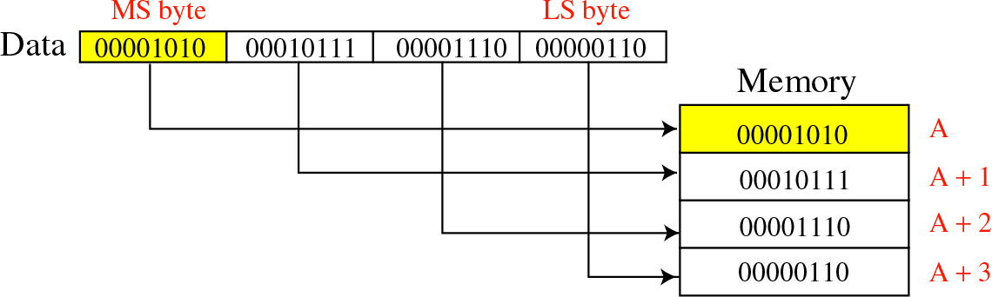
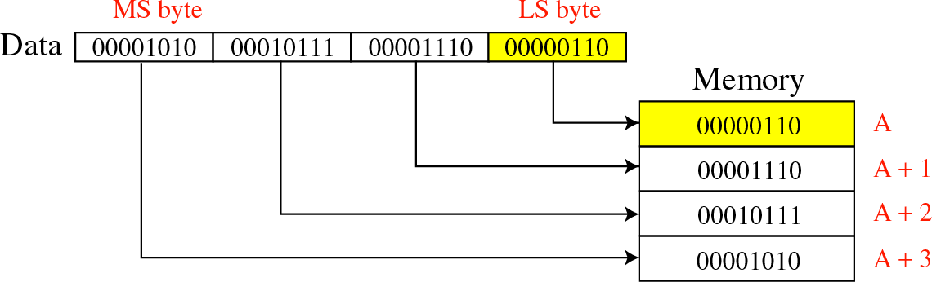
Constructing Messages - Byte Ordering
Big-Endian:
Little-Endian:

Slide 60
Constructing Messages - Byte Ordering -
Solution: Network Byte Ordering
Host Byte-Ordering: the byte ordering used by a host (big or little)
Network Byte-Ordering: the byte ordering used by the network – always big-endian
u_long htonl(u_long x);
u_short htons(u_short x);
u_long ntohl(u_long x);
u_short ntohs(u_short x);
On big-endian machines, these routines do nothing
On little-endian machines, they reverse the byte order
n Little mach
-Endian
ine
12
40
119
128
128 | 119 | 40 | 12
Big-Endia
machine
128
.119.4
0.12
128
.119.4
0.12
htonl
ntohl
128 | 119 | 40 | 12
128 | 119 | 40 | 12

Slide 61
Constructing Messages - Byte Ordering -
Example
Client
unsigned short clientPort, message; unsigned int messageLenth;
servPort = 1111;
message = htons(clientPort); messageLength = sizeof(message);
if (sendto( clientSock, message, messageLength, 0,
(struct sockaddr *) &echoServAddr, sizeof(echoServAddr))
!= messageLength)
DieWithError("send() sent a different number of bytes than expected");
Server
unsigned short clientPort, rcvBuffer; unsigned int recvMsgSize ;
if ( recvfrom(servSock, &rcvBuffer, sizeof(unsigned int), 0),
(struct sockaddr *) &echoClientAddr, sizeof(echoClientAddr)) < 0) DieWithError(“recvfrom() failed");
clientPort = ntohs(rcvBuffer);
printf (“Client’s port: %d”, clientPort);

Slide 62
Constructing Messages - Alignment and Padding
consider the following 12 byte structure
typedef struct { int x;
short x2; int y; short y2;
} msgStruct;
After compilation it will be a 14 byte structure!
Why? € Alignment!
Remember the following rules:
data structures are maximally aligned, according to the size of the largest native integer
other multibyte fields are aligned to their size, e.g., a four-byte integer’s address will be divisible by four
x | x2 | y | y2
x | x2 | [pad] | y | y2
4 bytes 2 bytes 4 bytes 2 bytes
This can be avoided
include padding to data structure
reorder fields
4 bytes 2 bytes 2 bytes 4 bytes 2 bytes
typedef struct { int x;
short x2; char pad[2]; int y;
short y2;
} msgStruct;
typedef struct { int x;
int y; short x2; short y2;
} msgStruct;

Slide 63
Constructing Messages - Framing and Parsing
Framing is the problem of formatting the information so that the receiver can parse messages
Parse means to locate the beginning and the end of message
This is easy if the fields have fixed sizes
e.g., msgStruct
For text-string representations is harder
Solution: use of appropriate delimiters
caution is needed since a call of recv may return the messages sent by multiple calls of send

Slide 64
Socket Options
getsockopt and setsockopt allow socket options values to be queried and set, respectively
int getsockopt (sockid, level, optName, optVal, optLen);
sockid: integer, socket descriptor
level: integer, the layers of the protocol stack (socket, TCP, IP)
optName: integer, option
optVal: pointer to a buffer; upon return it contains the value of the specified option
optLen: integer, in-out parameter it returns -1 if an error occured
int setsockopt (sockid, level, optName, optVal, optLen);
optLen is now only an input parameter

Slide 65
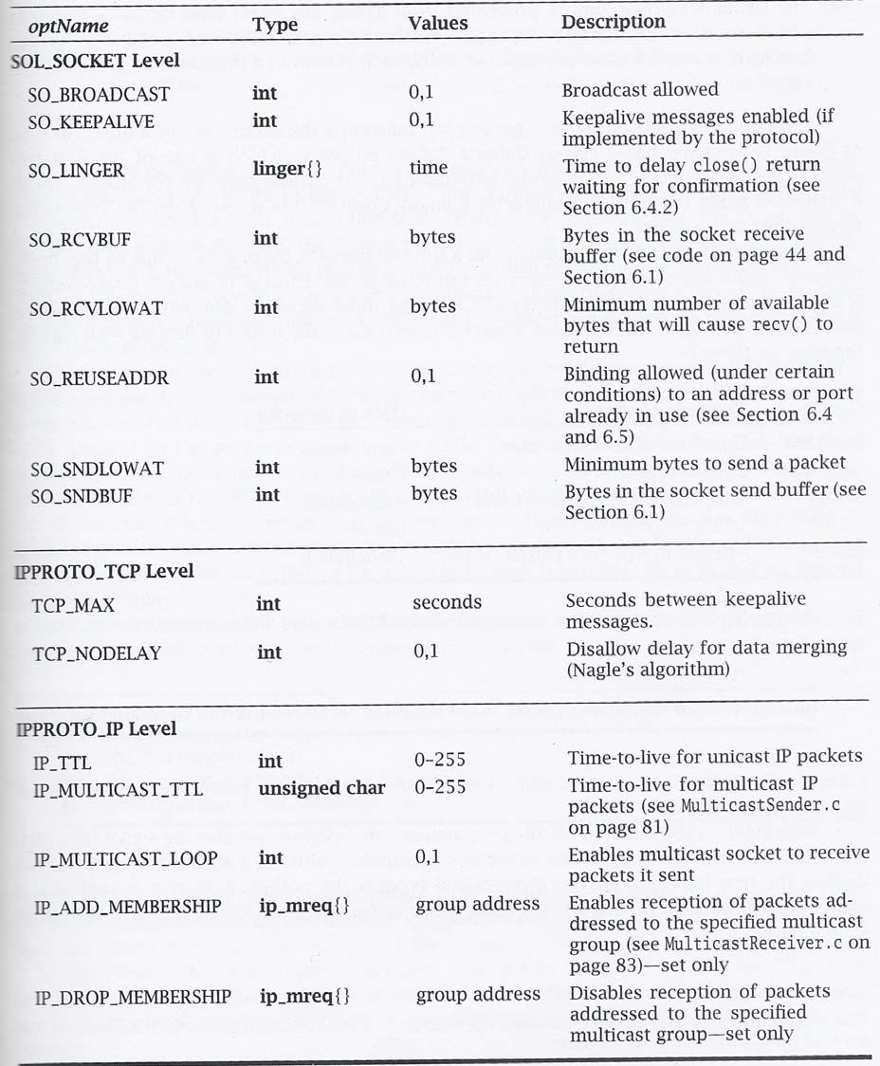
Socket Options
- Table

Slide 66
Socket Options - Example
Fetch and then double the current number of bytes in the socket’s receive buffer
int rcvBufferSize; int sockOptSize;
…
/* Retrieve and print the default buffer size */
sockOptSize = sizeof(recvBuffSize);
if (getsockopt(sock, SOL_SOCKET, SO_RCVBUF, &rcvBufferSize, &sockOptSize) < 0) DieWithError(“getsockopt() failed”);
printf(“Initial Receive Buffer Size: %d\n”, rcvBufferSize);
/* Double the buffer size */
recvBufferSize *= 2;
/* Set the buffer size to new value */
if (setsockopt(sock, SOL_SOCKET, SO_RCVBUF, &rcvBufferSize, sizeof(rcvBufferSize)) < 0)
DieWithError(“getsockopt() failed”);
66

Slide 67
Dealing with blocking calls
Many of the functions we saw block (by default) until a certain event
accept: until a connection comes in
connect: until the connection is established
recv, recvfrom: until a packet (of data) is received
what if a packet is lost (in datagram socket)?
send: until data are pushed into socket’s buffer
sendto: until data are given to the network subsystem
For simple programs, blocking is convenient
What about more complex programs?
multiple connections
simultaneous sends and receives
simultaneously doing non-networking processing
67

Slide 68
Dealing with blocking calls
Non-blocking Sockets
Asynchronous I/O
Timeouts
68

Slide 69
Non-blocking Sockets
If an operation can be completed immediately, success is returned; otherwise, a failure is returned (usually -1)
errno is properly set, to distinguish this (blocking) failure from other - (EINPROGRESS for connect, EWOULDBLOCK for the other)
1st Solution: int fcntl (sockid, command, argument);
sockid: integer, socket descriptor
command: integer, the operation to be performed (F_GETFL, F_SETFL)
argument: long, e.g. O_NONBLOCK
 fcntl (sockid, F_SETFL, O_NONBLOCK);
2nd Solution: flags parameter of send, recv, sendto, recvfrom
MSG_DONTWAIT
not supported by all implementations
69

Slide 70
Signals
Provide a mechanism for operating system to notify processes that certain events occur
e.g., the user typed the “interrupt” character, or a timer expired
signals are delivered asynchronously
upon signal delivery to program
it may be ignored, the process is never aware of it
the program is forcefully terminated by the OS
a signal-handling routine, specified by the program, is executed
this happens in a different thread
the signal is blocked, until the program takes action to allow its delivery
each process (or thread) has a corresponding mask
Each signal has a default behavior
e.g. SIGINT (i.e., Ctrl+C) causes termination
it can be changed using sigaction()
Signals can be nested (i.e., while one is being handled another is delivered)
70

Slide 71
Signals
int sigaction(whichSignal, &newAction, &oldAction);
whichSignal: integer
newAction: struct sigaction, defines the new behavior
oldAction: struct sigaction, if not NULL, then previous behavior is copied
it returns 0 on success, -1 otherwise
struct sigaction {
void (*sa_handler)(int); /* Signal handler */
sigset_t sa_mask; /* Signals to be blocked during handler execution */ int sa_flags; /* Flags to modify default behavior */
};
sa_handler determines which of the first three possibilities occurs when signal is delivered, i.e., it is not masked
SIG_IGN, SIG_DFL, address of a function
sa_mask specifies the signals to be blocked while handling whichSignal
whichSignal is always blocked
it is implemented as a set of boolean flags
int sigemptyset (sigset_t *set); /* unset all the flags */
int sigfullset (sigset_t *set); /* set all the flags */
int sigaddset(sigset_t *set, int whichSignal); /* set individual flag */
int sigdelset(sigset_t *set, int whichSignal); /* unset individual flag */
71

Slide 72
Signals - Example
#include <stdio.h> #include <signal.h> #include <unistd.h>
void DieWithError(char *errorMessage);
void InterruptSignalHandler(int signalType);
int main (int argc, char *argv[]) {
struct sigaction handler;
handler.sa_handler = InterruptSignalHandler;
if (sigfillset(&handler.sa_mask) < 0) DieWithError (“sigfillset() failed”);
handler.sa_flags = 0;
if (sigaction(SIGINT, &handler, 0) < 0) DieWithError (“sigaction() failed”);
for(;;) pause(); exit(0);
}
/* Signal handler specification structure */
/* Set handler function */
/* Create mask that masks all signals */
/* Set signal handling for interrupt signals */
/* Suspend program until signal received */
void InterruptHandler (int signalType) {
printf (“Interrupt received. Exiting program.\n); exit(1);
}
72

Slide 73
Asynchronous I/O
 Non-blocking sockets require “polling”
 With asynchronous I/O the operating system informs the program when a socket call is completed
the SIGIO signal is delivered to the process, when some I/O-related event occurs on the socket
Three steps:
/* i. inform the system of the desired disposition of the signal */ struct sigaction handler; handler.sa_handler = SIGIOHandler;
if (sigfillset(&handler.sa_mask) < 0) DiewithError(“…”); handler.sa_flags = 0;
if (sigaction(SIGIO, &handler, 0) < 0) DieWithError(“…”);
/* ii. ensure that signals related to the socket will be delivered to this process */
if (fcntl(sock, F_SETOWN, getpid()) < 0) DieWithError();
/* iii. mark the socket as being primed for asynchronous I/O */
if (fcntl(sock, F_SETFL, O_NONBLOCK | FASYNC) < 0) DieWithError();
73

Slide 74
Timeouts
Using asynchronous I/O the operating system informs the program for the occurrence of an I/O related event
what happens if a UPD packet is lost?
We may need to know if something doesn’t happen after some time
unsigned int alarm (unsigned int secs);
starts a timer that expires after the specified number of seconds (secs)
returns
the number of seconds remaining until any previously scheduled alarm was due to be delivered,
or zero if there was no previously scheduled alarm
process receives SIGALARM signal when timer expires and errno is set to
EINTR
74

Slide 75
Asynchronous I/O - Example
/* Inform the system of the desired disposition of the signal */ struct sigaction myAction; myAction.sa_handler = CatchAlarm;
if (sigfillset(&myAction.sa_mask) < 0) DiewithError(“…”); myAction.sa_flags = 0;
if (sigaction(SIGALARM, &handler, 0) < 0) DieWithError(“…”);
/* Set alarm */
alarm(TIMEOUT_SECS);
/* Call blocking receive */
if (recvfrom(sock, echoBuffer, ECHOMAX, 0, … ) < 0) { if (errno = EINTR) … /*Alarm went off */
else DieWithError(“recvfrom() failed”);
}
75

Slide 76
Iterative Stream Socket Server
Handles one client at a time
Additional clients can connect while one is being served
connections are established
they are able to send requests
but, the server will respond after it finishes with the first client
 Works well if each client required a small, bounded amount of work by the server
 otherwise, the clients experience long delays
76

Slide 77
Iterative Server - Example: echo using stream socket
#include <stdio.h> /* for printf() and fprintf() */
#include <sys/socket.h> /* for socket(), bind(), connect(), recv() and send() */
#include <arpa/inet.h> #include <stdlib.h> #include <string.h> #include <unistd.h>
/* for sockaddr_in and inet_ntoa() */
/* for atoi() and exit() */
/* for memset() */
/* for close() */
#define MAXPENDING 5 /* Maximum outstanding connection requests */
void DieWithError(char *errorMessage); /* Error handling function */
void HandleTCPClient(int clntSocket); /* TCP client handling function */
int main(int argc, char *argv[]) { int servSock;
int clntSock;
/* Socket descriptor for server */
/* Socket descriptor for client */
struct sockaddr_in echoServAddr; /* Local address */ struct sockaddr_in echoClntAddr; /* Client address */
unsigned short echoServPort; unsigned int clntLen;
/* Server port */
/* Length of client address data structure */
if (argc != 2) { /* Test for correct number of arguments */ fprintf(stderr, "Usage: %s <Server Port>\n", argv[0]); exit(1);
}
echoServPort = atoi(argv[1]); /* First arg: local port */
/* Create socket for incoming connections */
if ((servSock = socket(PF_INET, SOCK_STREAM, IPPROTO_TCP)) < 0) DieWithError("socket() failed");
...
77

Slide 78
Iterative Server - Example: echo using stream socket
...
/* Construct local address structure */ memset(&echoServAddr, 0, sizeof(echoServAddr)); echoServAddr.sin_family = AF_INET;
/* Zero out structure */
/* Internet address family */
echoServAddr.sin_addr.s_addr = htonl(INADDR_ANY); /* Any incoming interface */
echoServAddr.sin_port = htons(echoServPort); /* Local port */
/* Bind to the local address */
if (bind(servSock, (struct sockaddr *) &echoServAddr, sizeof(echoServAddr)) < 0) DieWithError("bind() failed");
/* Mark the socket so it will listen for incoming connections */ if (listen(servSock, MAXPENDING) < 0)
DieWithError("listen() failed");
for (;;) /* Run forever */
{
/* Set the size of the in-out parameter */ clntLen = sizeof(echoClntAddr);
/* Wait for a client to connect */
if ((clntSock = accept(servSock, (struct sockaddr *) &echoClntAddr,
&clntLen)) < 0) DieWithError("accept() failed");
/* clntSock is connected to a client! */
printf("Handling client %s\n", inet_ntoa(echoClntAddr.sin_addr)); HandleTCPClient(clntSock);
}
/* NOT REACHED */
}
78

Slide 79
Iterative Server - Example: echo using stream socket
#define RCVBUFSIZE 32 /* Size of receive buffer */
void HandleTCPClient(int clntSocket)
{
char echoBuffer[RCVBUFSIZE]; int recvMsgSize;
/* Buffer for echo string */
/* Size of received message */
/* Receive message from client */
if ((recvMsgSize = recv(clntSocket, echoBuffer, RCVBUFSIZE, 0)) < 0) DieWithError("recv() failed");
/* Send received string and receive again until end of transmission */ while (recvMsgSize > 0) /* zero indicates end of transmission */
{
/* Echo message back to client */
if (send(clntSocket, echoBuffer, recvMsgSize, 0) != recvMsgSize) DieWithError("send() failed");
/* See if there is more data to receive */
if ((recvMsgSize = recv(clntSocket, echoBuffer, RCVBUFSIZE, 0)) < 0) DieWithError("recv() failed");
}
close(clntSocket); /* Close client socket */
}
79

Slide 80
Multitasking - Per-Client Process
For each client connection request, a new process is created to handle the communication
int fork();
a new process is created, identical to the calling process, except for its process ID and the return value it receives from fork()
returns 0 to child process, and the process ID of the new child to parent
Caution:
when a child process terminates, it does not automatically disappears
use waitpid() to parent in order to “harvest” zombies
80

Slide 81
Multitasking - Per-Client Process
- Example: echo using stream socket
#include <sys/wait.h> /* for waitpid() */
int main(int argc, char *argv[]) { int servSock;
int clntSock;
unsigned short echoServPort;
pid_t processID;
unsigned int childProcCount = 0;
/* Socket descriptor for server */
/* Socket descriptor for client */
/* Server port */
/* Process ID from fork()*/
/* Number of child processes */
if (argc != 2) { /* Test for correct number of arguments */ fprintf(stderr, "Usage: %s <Server Port>\n", argv[0]); exit(1);
}
echoServPort = atoi(argv[1]); /* First arg: local port */
servSock = CreateTCPServerSocket(echoServPort); for (;;) { /* Run forever */
clntSock = AcceptTCPConnection(servSock);
if ((processID = fork()) < 0) DieWithError (“fork() failed”); /* Fork child process */
else if (processID = 0) { close(servSock); HandleTCPClient(clntSock); exit(0);
}
/* This is the child process */
/* child closes listening socket */
/* child process terminates */
close(clntSock); childProcCount++;
/* parent closes child socket */
/* Increment number of outstanding child processes */
...
81

Slide 82
Multitasking - Per-Client Process
- Example: echo using stream socket
...
while (childProcCount) {
processID = waitpid((pid_t) -1, NULL, WHOANG); if (processID < 0) DieWithError (“...”);
else if (processID == 0) break; else childProcCount--;
}
/* Clean up all zombies */
/* Non-blocking wait */
/* No zombie to wait */
/* Cleaned up after a child */
}
/* NOT REACHED */
}
82

Slide 83
Multitasking - Per-Client Thread
 Forking a new process is expensive
duplicate the entire state (memory, stack, file/socket descriptors, …)
 Threads decrease this cost by allowing multitasking within the same process
threads share the same address space (code and data)
An example is provided using POSIX Threads
83

Slide 84
Multitasking - Per-Client Thread
- Example: echo using stream socket
#include <pthread.h>
/* for POSIX threads */
void *ThreadMain(void *arg)
/* Main program of a thread */
struct ThreadArgs { int clntSock;
};
/* Structure of arguments to pass to client thread */
/* socket descriptor for client */
int main(int argc, char *argv[]) { int servSock;
int clntSock;
unsigned short echoServPort;
pthread_t threadID;
struct ThreadArgs *threadArgs;
/* Socket descriptor for server */
/* Socket descriptor for client */
/* Server port */
/* Thread ID from pthread_create()*/
/* Pointer to argument structure for thread */
if (argc != 2) { /* Test for correct number of arguments */ fprintf(stderr, "Usage: %s <Server Port>\n", argv[0]); exit(1);
}
echoServPort = atoi(argv[1]); /* First arg: local port */
servSock = CreateTCPServerSocket(echoServPort); for (;;) { /* Run forever */
clntSock = AcceptTCPConnection(servSock);
/* Create separate memory for client argument */
if ((threadArgs = (struct ThreadArgs *) malloc(sizeof(struct ThreadArgs)))) == NULL) DieWithError(“…”);
threadArgs -> clntSock = clntSock;
/* Create client thread */
if (pthread_create (&threadID, NULL, ThreadMain, (void *) threadArgs) != 0) DieWithError(“…”);
}
/* NOT REACHED */
}
84

Slide 85
Multitasking - Per-Client Thread
- Example: echo using stream socket
void *ThreadMain(void *threadArgs)
{
int clntSock; /* Socket descriptor for client connection */
pthread_detach(pthread_self()); /* Guarantees that thread resources are deallocated upon return */
/* Extract socket file descriptor from argument */
clntSock = ((struct ThreadArgs *) threadArgs) -> clntSock; free(threadArgs); /* Deallocate memory for argument */
HandleTCPClient(clntSock); return (NULL);
}
85

Slide 86
Multitasking - Constrained
Both process and thread incurs overhead
creation, scheduling and context switching
As their numbers increases
this overhead increases
after some point it would be better if a client was blocked
Solution: Constrained multitasking. The server:
begins, creating, binding and listening to a socket
creates a number of processes, each loops forever and accept connections from the same socket
when a connection is established
the client socket descriptor is returned to only one process
the other remain blocked
86

Slide 87
Multitasking - Constrained
- Example: echo using stream socket
void ProcessMain(int servSock); /* Main program of process */
int main(int argc, char *argv[]) { int servSock;
unsigned short echoServPort; pid_t processID;
unsigned int processLimit; unsigned int processCt;
/* Socket descriptor for server*/
/* Server port */
/* Process ID */
/* Number of child processes to create */
/* Process counter */
if (argc != 3) { /* Test for correct number of arguments */ fprintf(stderr,"Usage: %s <SERVER PORT> <FORK LIMIT>\n", argv[0]); exit(1);
}
echoServPort = atoi(argv[1]); /* First arg: local port */
processLimit = atoi(argv[2]); /* Second arg: number of child processes */
servSock = CreateTCPServerSocket(echoServPort);
for (processCt=0; processCt < processLimit; processCt++)
if ((processID = fork()) < 0) DieWithError("fork() failed"); else if (processID == 0) ProcessMain(servSock);
/* Fork child process */
/* If this is the child process */
exit(0); /* The children will carry on */
}
void ProcessMain(int servSock) {
int clntSock; /* Socket descriptor for client connection */
for (;;) { /* Run forever */
clntSock = AcceptTCPConnection(servSock);
printf("with child process: %d\n", (unsigned int) getpid()); HandleTCPClient(clntSock);
}
}
87

Slide 88
Multiplexing
So far, we have dealt with a single I/O channel
We may need to cope with multiple I/O channels
e.g., supporting the echo service over multiple ports
Problem: from which socket the server should accept connections or receive messages?
it can be solved using non-blocking sockets
 but it requires polling
Solution: select()
specifies a list of descriptors to check for pending I/O operations
blocks until one of the descriptors is ready
returns which descriptors are ready
88

Slide 89
Multiplexing
int select (maxDescPlus1, &readDescs, &writeDescs, &exceptionDescs, &timeout);
maxDescsPlus1: integer, hint of the maximum number of descriptors
readDescs: fd_set, checked for immediate input availability
writeDescs: fd_set, checked for the ability to immediately write data
exceptionDescs: fd_set, checked for pending exceptions
timeout: struct timeval, how long it blocks (NULL € forever)
returns the total number of ready descriptors, -1 in case of error
changes the descriptor lists so that only the corresponding positions are set
int FD_ZERO (fd_set *descriptorVector);
int FD_CLR (int descriptor, fd_set *descriptorVector); int FD_SET (int descriptor, fd_set *descriptorVector);
/* removes all descriptors from vector */
/* remove descriptor from vector */
/* add descriptor to vector */
/* vector membership check */
int FD_ISSET (int descriptor, fd_set *descriptorVector);
struct timeval {
time_t tv_sec; /* seconds */ time_t tv_usec; /* microseconds */
};
89

Slide 90
Multiplexing - Example: echo using stream socket
#include <sys/time.h> /* for struct timeval {} */
int main(int argc, char *argv[])
{
int *servSock;
int maxDescriptor; fd_set sockSet; long timeout;
struct timeval selTimeout; int running = 1;
int noPorts; int port;
unsigned short portNo;
/* Socket descriptors for server */
/* Maximum socket descriptor value */
/* Set of socket descriptors for select() */
/* Timeout value given on command-line */
/* Timeout for select() */
/* 1 if server should be running; 0 otherwise */
/* Number of port specified on command-line */
/* Looping variable for ports */
/* Actual port number */
if (argc < 3) { /* Test for correct number of arguments */ fprintf(stderr, "Usage: %s <Timeout (secs.)> <Port 1> ...\n", argv[0]); exit(1);
}
timeout = atol(argv[1]); noPorts = argc - 2;
/* First arg: Timeout */
/* Number of ports is argument count minus 2 */
servSock = (int *) malloc(noPorts * sizeof(int)); /* Allocate list of sockets for incoming connections */ maxDescriptor = -1; /* Initialize maxDescriptor for use by select() */
for (port = 0; port < noPorts; port++) { portNo = atoi(argv[port + 2]);
/* Create list of ports and sockets to handle ports */
/* Add port to port list. Skip first two arguments */
servSock[port] = CreateTCPServerSocket(portNo); /* Create port socket */
if (servSock[port] > maxDescriptor) /* Determine if new descriptor is the largest */ maxDescriptor = servSock[port];
}
...
90

Slide 91
Multiplexing - Example: echo using stream socket
printf("Starting server: Hit return to shutdown\n"); while (running) {
/* Zero socket descriptor vector and set for server sockets */
/* This must be reset every time select() is called */ FD_ZERO(&sockSet);
FD_SET(STDIN_FILENO, &sockSet); /* Add keyboard to descriptor vector */ for (port = 0; port < noPorts; port++) FD_SET(servSock[port], &sockSet);
/* Timeout specification */
/* This must be reset every time select() is called */ selTimeout.tv_sec = timeout; /* timeout (secs.) */ selTimeout.tv_usec = 0; /* 0 microseconds */
/* Suspend program until descriptor is ready or timeout */
if (select(maxDescriptor + 1, &sockSet, NULL, NULL, &selTimeout) == 0) printf("No echo requests for %ld secs...Server still alive\n", timeout);
else {
if (FD_ISSET(0, &sockSet)) { /* Check keyboard */ printf("Shutting down server\n");
getchar(); running = 0;
}
for (port = 0; port < noPorts; port++)
if (FD_ISSET(servSock[port], &sockSet)) { printf("Request on port %d: ", port); HandleTCPClient(AcceptTCPConnection(servSock[port]));
}
}
}
for (port = 0; port < noPorts; port++) close(servSock[port]); /* Close sockets */ free(servSock); /* Free list of sockets */
exit(0);
}
91

Slide 92
Multiple Recipients
So far, all sockets have dealt with unicast communication
i.e., an one-to-one communication, where one copy (“uni”) of the data is sent (“cast”)
what if we want to send data to multiple recipients?
1st Solution: unicast a copy of the data to each recipient
 inefficient, e.g.,
consider we are connected to the internet through a 3Mbps line
a video server sends 1-Mbps streams
then, server can support only three clients simultaneously
2nd Solution: using network support
broadcast, all the hosts of the network receive the message
multicast, a message is sent to some subset of the host
for IP: only UDP sockets are allowed to broadcast and multicast
92

Slide 93
Multiple Recipients - Broadcast
Only the IP address changes
Local broadcast: to address 255.255.255.255
send the message to every host on the same broadcast network
not forwarded by the routers
Directed broadcast:
for network identifier 169.125 (i.e., with subnet mask 255.255.0.0)
the directed broadcast address is 169.125.255.255
No network-wide broadcast address is available
why?
 In order to use broadcast the options of socket must change:
int broadcastPermission = 1;
setsockopt(sock, SOL_SOCKET, SO_BROADCAST, (void*) &broadcastPermission, sizeof(broadcastPermission));
93

Slide 94
Multiple Recipients - Multicast
Using class D addresses
range from 224.0.0.0 to 239.255.255.255
hosts send multicast requests for specific addresses
a multicast group is formed
 we need to set TTL (time-to-live), to limit the number of hops
- using sockopt()
 no need to change the options of socket
94

Slide 95
Useful Functions
int atoi(const char *nptr);
converts the initial portion of the string pointed to by nptr to int
int inet_aton(const char *cp, struct in_addr *inp);
converts the Internet host address cp from the IPv4 numbers-and- dots notation into binary form (in network byte order)
stores it in the structure that inp points to.
it returns nonzero if the address is valid, and 0 if not
char *inet_ntoa(struct in_addr in);
converts the Internet host address in, given in network byte order, to a string in IPv4 dotted-decimal notation
typedef uint32_t in_addr_t;
struct in_addr { in_addr_t s_addr;
};
95

Slide 96
Useful Functions
int getpeername(int sockfd, struct sockaddr *addr, socklen_t *addrlen);
returns the address (IP and port) of the peer connected to the socket
sockfd, in the buffer pointed to by addr
0 is returned on success; -1 otherwise
int getsockname(int sockfd, struct sockaddr *addr, socklen_t *addrlen);
returns the current address to which the socket sockfd is bound, in the buffer pointed to by addr
0 is returned on success; -1 otherwise
96

Slide 97
Domain Name Service
struct hostent *gethostbyname(const char *name);
returns a structure of type hostent for the given host name
name is a hostname, or an IPv4 address in standard dot notation
e.g.
gethostbyname(“www.csd.uoc.gr”);
struct hostent *gethostbyaddr(const void *addr, socklen_t len, int type);
returns a structure of type hostent for the given host address addr of length len and address type type
struct hostent {
char | *h_name; | /* official name of host */
char | **h_aliases; | /* alias list (strings) */
int | h_addrtype; | /* host address type (AF_INET) */
int | h_length; | /* length of address */
char | **h_addr_list; | /* list of addresses (binary in network byte order) */
}
#define h_addr h_addr_list[0] /* for backward compatibility */
97

Slide 98
Domain Name Service
struct servent *getservbyname(const char *name, const char *proto);
returns a servent structure for the entry from the database that matches the service name using protocol proto.
if proto is NULL, any protocol will be matched.
e.g. getservbyname(“echo”, “tcp”) ;
struct servent *getservbyport(int port, const char
*proto);
returns a servent structure for the entry from the database that matches the service name using port port
struct servent { char *s_name;
/* official service name */
/* list of alternate names (strings)*/
/* service port number */
/* protocol to use (“tcp” or “udp”)*/
char **s_aliases;
int s_port; char *s_proto;
}
98

Slide 99
Compiling and Executing
include the required header files
Example:
milo:~/CS556/sockets> gcc -o TCPEchoServer TCPEchoServer.c DieWithError.c HandleTCPClient.c milo:~/CS556/sockets> gcc -o TCPEchoClient TCPEchoClient.c DieWithError.c milo:~/CS556/sockets> TCPEchoServer 3451 &
[1] 6273
milo:~/CS556/sockets> TCPEchoClient 0.0.0.0 hello! 3451
Handling client 127.0.0.1
Received: hello! milo:~/CS556/sockets> ps
PID TTY
5128 pts/9
6273 pts/9
6279 pts/9
TIME CMD
00:00:00 tcsh
00:00:00 TCPEchoServer
00:00:00 ps
milo:~/CS556/sockets> kill 6273 milo:~/CS556/sockets>
[1] Terminated milo:~/CS556/sockets>
TCPEchoServer 3451
99

Slide 100

The End - Questions
100

